Slide 1
Transportation Mode Identification
By: Stephanie Boehm, Bella Patel, and Albert Yen

Slide 2
Data Preparation

Slide 3
Data Set
Methods Tried
9 unique sensors (mean, min, max, std) and time
Normalized data with two methods, max and z-score
5 targets are Bus, Car, Still, Train and Walking
Logistic Regression
Support Vector Machine
Classification Trees
K-Means (Did not work)
Notes:
9 unique sensors (accelaration, rotation, gyroscope) with mean/min/max variables for a total of 37 variables and time
We normalized the data using max and z-score. The five targets are bus, car, still, train, and walking.

Slide 4
Logistic Regression
Notes:
The first method we tried on this dataset was logistic regression.

Slide 5
Process
R^2
Continuous predictors
Binary Target
Pairwise classification
R-squared - "goodness of fit"; how much of your data is explained by the data.
Walking: 0.693
Bus: 0.303
Train: 0.344
Still: 0.495
Car: 0.365
Notes:
For the continuous predictors, we have the means of acceleration, gyroscope, sound, game rotation, linear acceleration, orientation, rotation vector, and speed. Logistic regression works on binary targets. Therefore, I combined several transportation modes into one class and completed binary classification that way. By completing this iteratively, I got five different regressions that describe the data.
When creating the regressions, we aimed for the highest possible R^2 values we can get. R-squared is "goodness of fit"; how much of our data is explained by the data. We found R-squared by measuring the ratio of the deviance in our models to the null. Higher the R-squared, the better the model.

Slide 6
Testing and Accuracy
Improvements
Compare classified vs actual
Training Data Accuracy: 72.89%
Test Data Accuracy: 71.79%
Logistic regression as a nonlinear classifier
Notes:
We tested our models by looping through all rows of the data and then inputting them into the predict function. The data would then be classified as the method that gives the highest probability. We computed the accuracy of the regressions by matching what was tested with the correct mode of transportation. We achieved about 72% accuracy on the the test data.
While 72% accuracy is decent, it could have been better. We used logistic regression as a linear classifier. So our classes were separated by linear boundaries. If we implemented logistic regression as a non linear classifier, we could have improved the test accuracy. We would need a better idea of the shape of the decision boundary, which we did not know. Since that was not easy to incorporate, we just acknowledge that we could have improved test accuracy this way.

Slide 7
Support Vector Machine

Slide 8
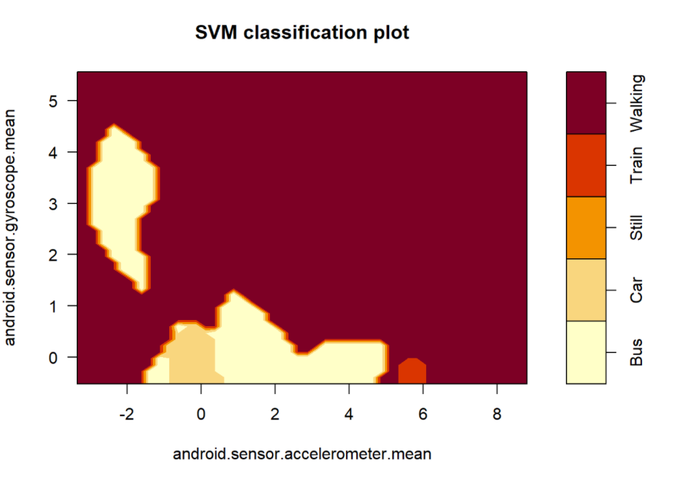
Process
Cross-validation to choose parameters
Polynomial kernel produced the highest accuracy
Correlation, boxplots and ANOVA used to look for best features
Normalized and non-normalized data used
Narrowed down sensors used

Slide 9
Accuracy of Tests
Variables Used | All Sensors and Time (All Measurements) | All Sensors and Time (Mean Only) | Important Sensors (Mean Only)
Accuracy of Test | 92.08% | 90.59% | 87.32%
Dataset Used | D First | D Second | D Third
Accuracy of Test | 50.76% | 62.33% | 64.71%

Slide 10
Decision Tree

Slide 11
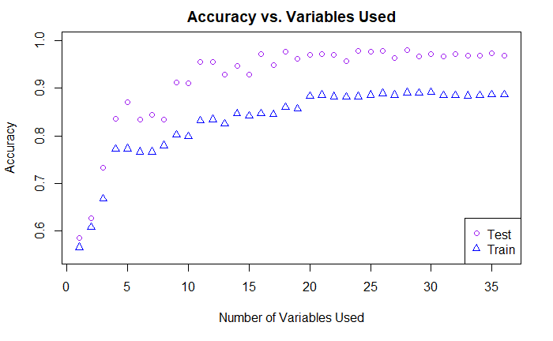
Classification Tree (Post-Pruning Method)
Cross Validation to find optimal cp
Best cp = 0.000315856 (for full model)
88.7% Accuracy
Type | Accuracy
Bus | 88.4%
Car | 87%
Still | 88.4%
Train | 89.9%
Walking | 90%

Slide 12
Wrap-Up

Slide 13
Comparison of Methods
Method | Logistic Regression | SVM | Decision Tree
Max. Accuracy | 72.79% | 92.1% | 89.1%
Variables Needed | 8 | 37 | 30
Simple Model Accuracy | - | 87.3% | 83.1%
Simple Model Variable # | - | 7 | 11

Slide 14
Most Important Sensors
Logistic Regression (8 sensors 71.7% accuracy)
Linear Acceleration
Accelerometer
Gyroscope
Speed
Sound
Rotation Vector
Game Rotation
Orientation
SVM (7 sensors 87.3% accuracy)
Rotation Vector
Speed
Orientation
Linear Acceleration
Sound
Gyroscope
Accelerometer
Decision Tree (7 sensors 88.3% accuracy)
Linear Acceleration
Accelerometer
Gyroscope
Speed
Sound
Rotation Vector
Time

Slide 15
Conclusions
Data is not linearly separable so logistic regression and clustering don’t work well
SVM yielded the best-performing model
Decision trees work best when number of sensors are limited (but require more variables)

